Slide 1
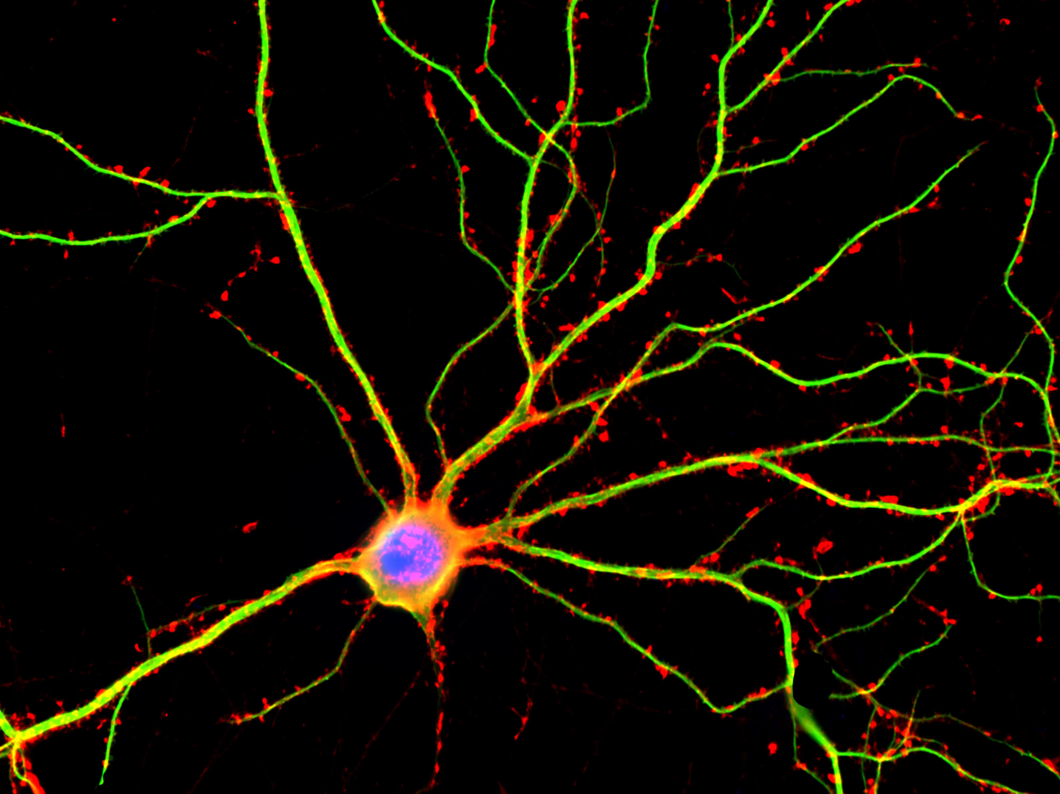
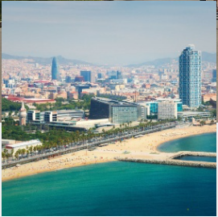
Neural development and neurological disorders
Head: Noelia Fernandez/ Isabelle Becam
Teaching objectives
The course consists in a series of specific seminars dealing with the general topic of neural development and neurological or psychiatric disorders. Each seminar of the course is followed by an open discussion or activities proposed by the speakers in which students are expected to participate actively. Therefore at the end of the course, students should be able to have critical assessment on scientific experiments and articles.
Teaching outline
The course is organized as a series of one- hour seminars seminars on topics dealing mainly with neural development end neurological or psychiatric disorder and the different system models that can be used to study these thematics. This seminar will be followed by one hour of discussion or activity related to the subject. A poster presentation is organized in which student will present their M2 project. The seminar will be held in the campus of the University of Barcelona.
Effectives: 20
Language: English
Where?
Barcelone
When?
December 12-16 2022
Evaluation:
Questions about the lectures
and/or analysis of a
scientific article
Questions:
isabelle.becam@ijm.fr
Number of ECTS: 4
Total numbers of hours:
30h
Teaching format: lectures
and poster presentation

