Slide 1
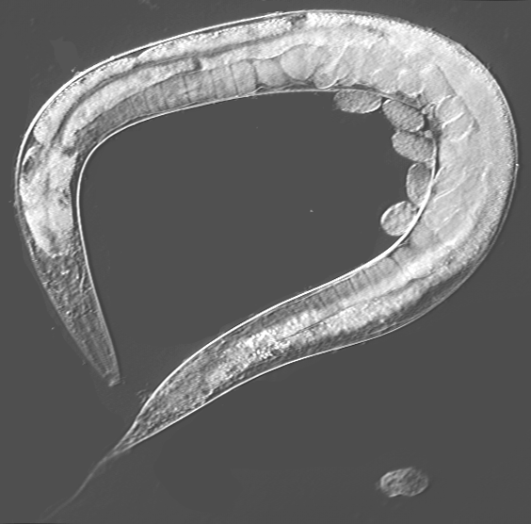
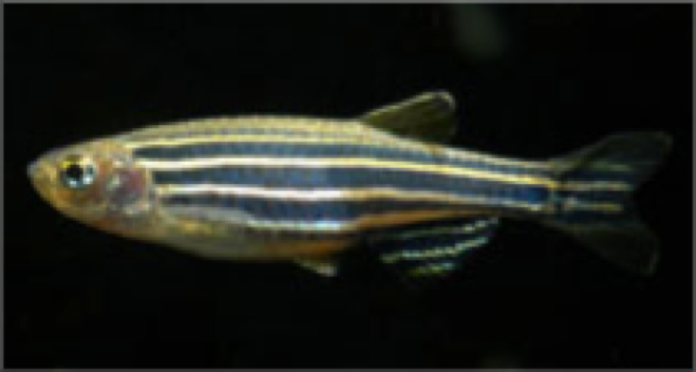
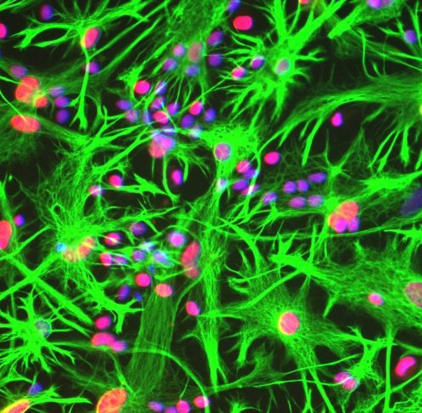
Models in genetic disease research
Mauro ZORDAN / Domenico FLAGIELLO
Teaching objectives
The course consists in a series of specific seminars dealing with the general topic of genetic diseases and the model organisms employed to study the molecular mechanisms involved in the physiopathology of the diseases. Each seminar proposed during the course is followed by an open discussion, thus at the end of the course, students are expected to have acquired the capacity to critically evaluate scientific papers.
Teaching outline
The course is organized as a series of one-hour seminars on topics dealing mainly with genetic diseases and the use of model organisms in genetic disease research. Topics typically touch upon molecular aspects of select genetic diseases and on the application of models such as in vitro mammalian cells, yeast, Drosophila, zebrafish and mouse to study the pathogenetic mechanisms of specific genetic defects.
Effectives: 20
Language: English
Where?
Padova
When?
October 24-28 / 2022
Evalutation:
Analysis of a scientific article
Questions:
dome.fla@gmail.com
Number ECTS : 4
Total numbers of hours
: 30h
Teaching format :
Lectures and poster
presentation

