Slide 1
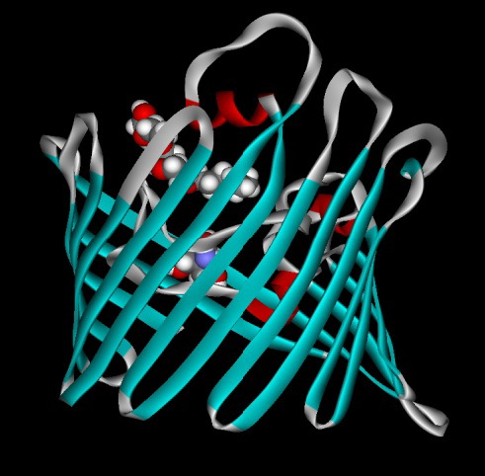
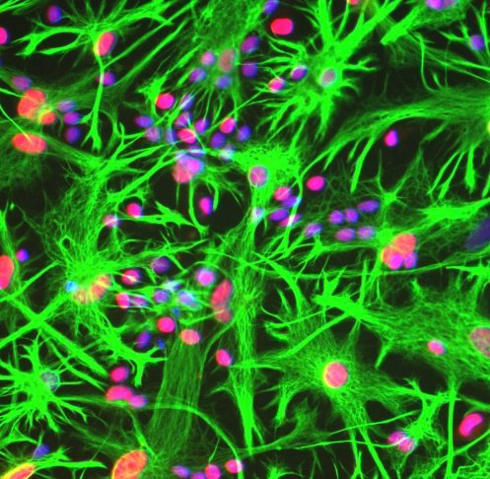
Multidisciplinary courses
Raffaella Meneveri/ Marzia Lecchi /
Domenico Flagiello
Teaching objectives
The course consists of a multidisciplinary series of seminars dealing with the molecular mechanisms of human diseases, which will be presented by scientists and clinicians from the University of Milano-Bicocca and from other Research Centers and Institutions. Each seminar will be followed by an open discussion in which students are encouraged to participate actively. The overall layout of the course is principally aimed at increasing students’ ability to critically analyze the scientific literature and to organize a research project.
Teaching outline
The course will be held in the University Campus and will be organized as a series of 2-hours seminars. At the end of the course, the students will take a written exam consisting in the critical analysis of a scientific paper dealing with one of the subjects discussed during the seminars. Moreover, a poster presentation will be held, in which students will present informally a scientific project they have been involved in.
Effectives: 20
Language: English
Where?
Milan
When?
October 24-28 / 2022
Evalutation:
Analysis of a scientific article
Questions:
dome.fla@gmail.com
Number ECTS : 4
Total numbers of hours
: 30h
Teaching format :
Lectures and poster
presentation

